Slide 1
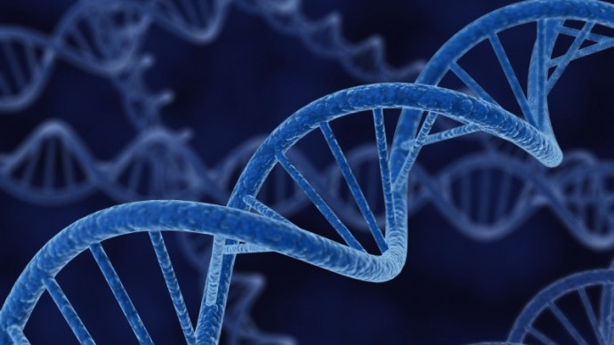

An Innovative, Game-changing Approach to Cancer Therapeutics: Succeeding Where Others Have Failed
February 2022
Dr Philip A Marshall
Chief Executive Officer

Slide 2
About Our Company
Purpose and Mission
Oncology Research International Limited (ORIL) was initially founded by a cancer survivor with the aim to investigate and develop new, effective and low-cost, plant-derived therapies for cancer.

Slide 3
Summary
Innovative technology tackling unmet needs in the rapidly growing cancer market
Candidate drug (ORIL019) identified and patented – a new immuno-oncology (I-O) drug therapy
Stimulates the body’s immune system to fight cancer
Validated by Nobel Prize-winning science (PD-1 inhibitors)
Unique and proven science – a new and different mode of action to other I-O drugs, selectively kills cancer cells
Stimulates and strengthens rather than weakens the immune system
Suitable as a sole treatment, or in combination with other cancer therapies proven to double tumour reductions
Strong IP portfolio, 100% owned by ORIL
Clear pathway forward to commercialization and ROI
Strong well-credentialed, international Advisory Board, management team & advisors
Addresses Global Impact Goals
An affordable cancer treatment for the world’s poorest and most remote communities

Slide 4
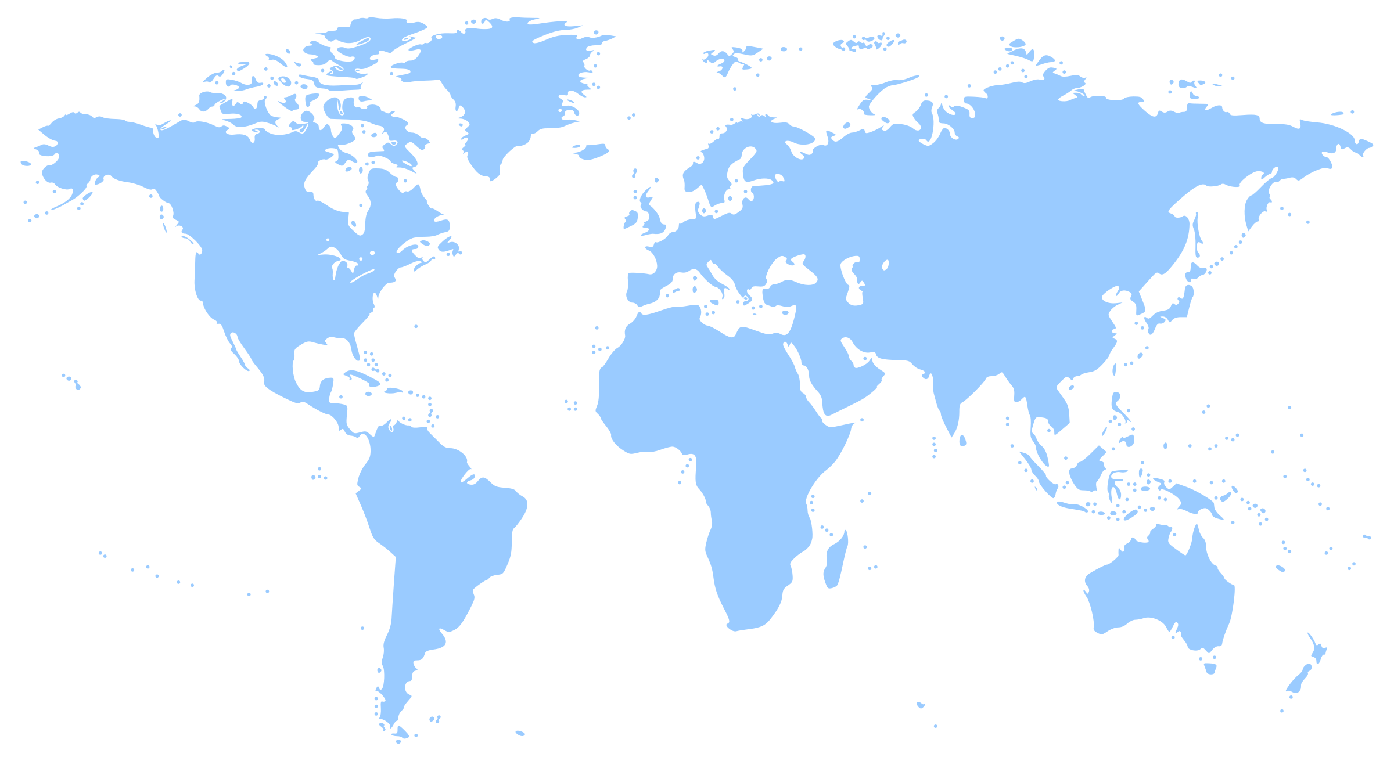
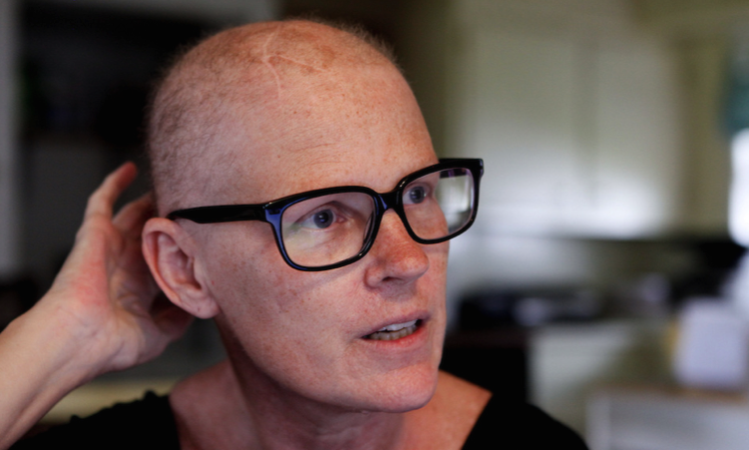
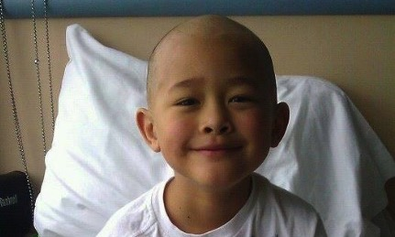
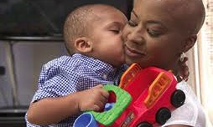
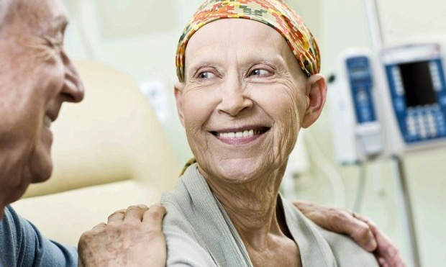
The Problem: Cancer - #2 Killer
A Worldwide Problem
Global Cancer Statistics
New Cases per Year (2020) | 19.3 million
Cancer Related Death (2020) | 9.9 million
New Cases per Year (by 2040) | 28.4 million
Global USD Spending 2021 | 167 billion
Global USD Spending 2022 Forecast | 206 billion
>64%
Projected global increase in the # of cancer cases over the next 10 years
page
04
Sources: CA Cancer J Clin. 2021 May;71(3):209-249, Health, Pharma & Medtech May 2021

Slide 5
Our Science
What is Immuno-therapy?
Cancer immuno-therapy is the stimulation of the immune system to treat cancer, improving on the immune system’s natural ability to fight the disease, by inducing, enhancing, or suppressing an immune response.
An I-O drug stimulates the body’s own defence systems into action against the invading cancer.
Immuno-therapy has revolutionized cancer treatment and fundamentally changed the way we view how cancer can be managed.
ORIL has discovered a different, scientifically-validated approach to cancer immuno-therapy and is a first-in-class therapy;
ORIL fills the gaps in I-O for combination therapy.

Slide 6
ORIL Differs from Mainstream I-O Therapies by
Effectively Targeting Today’s I-O Challenges
Current Immuno-Oncology Landscape
Spectacular Results to Date But a Few Challenges Remain
Results are spectacular with I-O when used against the protein PD-1 in several types of cancer
eg. lung, renal, lymphoma and melanoma
But………
Still fails in 80% of patients
Only results in modest increases in the overall survival rate (1.6 months)
Treatment is at very high costs to the patient (US$120,000+ annually)
Only works in a small subset of cancer types
No reliable biomarker yet to predict who responds well and who doesn’t
Overcoming tumour resistance and toxicity remains a problem

Slide 7
ORIL’s Science Validation
Immuno-therapy & Immuno-oncology
2018 Nobel Prize in Physiology or Medicine
awarded to Dr Tasuku Honjo (Japan) and Dr James P Allison (USA) for their
“discovery of cancer therapy by inhibition of negative immune regulation”.
https://www.nobelprize.org/prizes/medicine/2018/summary/
The ground-breaking work of Dr. Allison and Dr. Honjo showed how different strategies for inhibiting the brakes on the immune system (such as PD-1 inhibitors) can be used in the treatment of cancer patients.
This supports ORIL’s strategy.

Slide 8
ORIL R&D and Breakthroughs
The Development Story: Technical Challenges Solved
Starting Point:
Next: To Clinic/Patients
Plant extracts with proven anti-cancer activity
as found in Traditional Chinese Medicine
Plant Extracts
New I-T Drug Lead Candidate
ORIL019:
A First-Class, Small Molecule, Anti-Cancer Drug
Discovery 1:
A new method of manufacture (GMP)
Target and mode of action validated
Discovery 3:
A New Generation of Modern Medicine, Re-engineering to Overcome Issues
Discovery 2:
Multi-pronged Delivery
Design & development of:-
novel, water-soluble molecules
safe and well-tolerated by the body
high efficacy in immuno-therapy
New formulations for drug delivery:
Dermal gel
Tablets / Capsules
I.V.
Current Status: there are no more technical barriers to completing pre-clinical trials in the next 18 months.

Slide 9


ORIL019 is the Lead Candidate Drug
The Solution
Targets the I-O Challenges
An extra, potent drug with a different target and mode of action that does not dampen the immune system;
acknowledged and recognized science appraised by independent experts during due diligence.
A new family of innovative small-molecule therapies to treat multiple cancers
page
09

Slide 10
ORIL Technology
Key Intellectual Property Rights
Title (Family) | Patent Application Number | Status
Methods and Compositions for promoting activity of anti-cancer therapies | PCT/AU2007/001091 | Granted in USA, Canada, China, Europe, India, Australia, Eurasia, Mexico and Japan.
Improved synthesis of a class of steroid saponins (Methods) | PCT/AU2013/000416 | Granted in Australia, China, Europe, Mexico Pending in USA and Canada.
Compounds (New Chemical Entities) Composition of Matter | PCT/AU2018/050099 | Granted in USA, Australia PCT published August 2018 National Phase Entry Aug 2019 Pending Europe, China
IP is 100% owned by ORIL
→ facilitates exclusivity
New patents further strengthen the robust commercial exclusivity put in place through a combination of composition of matter patents, method patents and orphan drug exclusivity
page
010

Slide 11
ORIL Pipeline Assets Development Platform
Potential in ORIL’s Scientific Evidence
Drug Development Pipeline
Therapeutic Area
Candidate
Indication
Discovery
Pre-Clinical / IND
Phase I/IB
Phase II
Phase III
New Drug Application
Under Development
Oncology
ORIL019
Colon cancer
Oncology
ORIL019
Prostate cancer
Oncology
ORIL019
Pancreatic cancer
Oncology
ORIL019 Combo
Colon, kidney, liver cancer
Discovery Stage
Anti-inflammatory
ORIL00F
Angiogenesis
Anti-viral (CoVid-19)
ORIL00F, NCEs
Covid-19
Anti-TREM2
ORIL00F
Alzheimer’s
Pipeline based on ORIL’s view of future designs in clinical trials, according to ORIL019 efficacy data and potential treatment of various indications
page
011

Slide 12

ORIL Technology
Other Therapeutic Applications
ORIL recognizes the need to diversify and build its product pipeline based on its platform technology
Pathogenic organisms and viruses e.g., anti-viral application to prevent the virus from “docking” on the host cell thereby preventing invasion and modifying cell processes, including CoVid-19
Cardiac disease – #1 global disease killer
Inflammatory diseases – such as inflammatory bowel disease
Diabetes –
  In 2019, the global prevalence of diabetes was estimated to be 463 million, expected to rise to 700 million by 2045
  In China alone, it is estimated there are 116 million people with diabetes
Neuro-degenerative diseases such as Alzheimer’s disease
Asthma
Cirrhosis of the liver
page
012
Source: International Diabetes Federation

Slide 13
Fundraising Plan
Currently at Stage 1 of 3 Tranches of Funding
Stage 1 AUD$5m (~US$3.5m) Use of Proceeds
Item | Budget (AU$m) | US$m
Preclinical R&D (ORIL019) Synthesis and scale-up ORIL019 Formulation/product development (i.v./oral) In vivo efficacy in another model Bioanalytical development Dose ranging and optimisation ADME, PK/PD Toxicology Clinic-ready activities | 4.3 | 3.1
Administration Operations, administration, governance, IP and patent portfolio management, support activities, commercial activities, etc. | 0.7 | 0.5
TOTAL | 5.0 | 3.6
Seek an immediate capital investment of AU$5.0m to complete pre-clinical in 18 months
Phase I/IB studies require further AU$5.0m and 12 months to complete
Phase II studies require a further AU$10.0m and is expected to take ~18 months to complete
R&D expenditure attracts 43.5% tax offset from Australian Tax Office, increasing the value of the R&D $$ spent
page
013

Slide 14
Fundraising Strategy
Phased Value Formation
$M
Stage 3: AUD$10m invested at Phase II
Stage 2: AUD$5m invested at Phase I
Clinical
Stage 1: AUD$5m invested now
clinic ready
ORIL
Discovery
Preclinical
Clinical
Registration/Market
Drug development has clear value creation providing exit opportunities with high ROI:
Phase 1 Exit of ~250-280% investor ROI; Phase 2 Exit of ~450% investor ROI.
page
014

Slide 15
ORIL’s Market Opportunity
Vibrant Deal Landscape
Global Cancer market size approx. US$167b in 2021 → US$206b by 2022
Immuno-therapy a major driver behind deal making: 32 of 35 multi-billion deals in last 5 years I-O focused
Oncology deal making shows a steep rise in activity: combined upfront value of deals 1H2018 of US$4.15b
58% of deals signed at the discovery stage: median upfront payment of US$17m in last 5 years
Early access to innovation important: 60% of deals done at pre-clinical or clinical Phase I stage
Small molecules attract a vast majority of oncology deals: ORIL019 is a small molecule, late pre-clinical stage
ORIL’s ROI and exit strategy is designed to reduce risk and offer a range of flexible exit options such as licensing, trade sale, IPO or in-kind collaboration and development; and a high investor ROI is achieved at each exit stage, supported by reduced risks & enhanced certainty.
page
015

Slide 16
ORIL Company Structure
Global Reach
BOARD OF DIRECTORS
Dr Philip Marshall (Acting Chairman)
Dr Michael Wayte
Mrs Helena Wayte
Investor Representative
ORIL does not have full time employees and engages external experts and relevant expertise as required depending on the stage of the project.
When funds become available appropriate consultants will be engaged to carry out the work as illustrated on the adjacent Organisational Chart.
Advisors
CHIEF EXECUTIVE OFFICER
Dr Philip Marshall
Current
Post Investment
CHEMISTRY & MANUFACTURING
Dr Brett Mooney
API & product development
CLINICAL
CRO
(Hong Kong &/or Australia)
Principal Investigator
(c/-the Study centre)
Ms Elizabeth Wilkinson
(GCP compliance, management)
Dr Philip McCloud
(biostatistics, clinical database)
INT’L BUSINESS DEVELOPMENT
TBA
PRE-CLINICAL
Dr Fernando Felquer
pre-clinical protocols project management
Dr John Langlands
toxicology & pharmacology
REGULATORY
Dr John Langlands
FDA regulatory expert
page
016

Slide 17
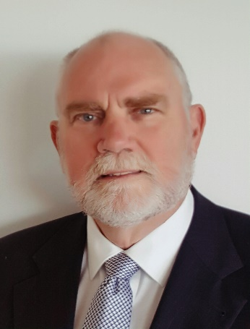
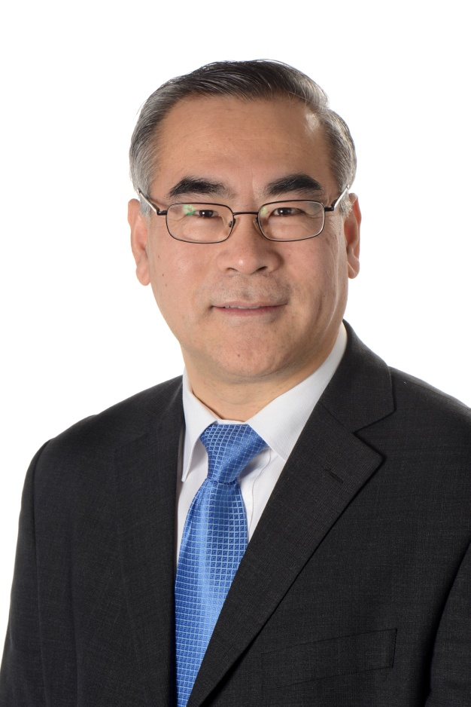
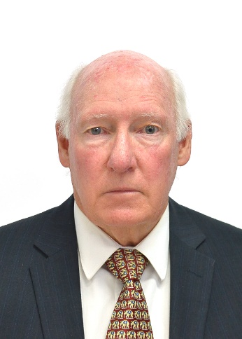
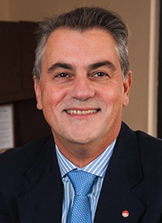
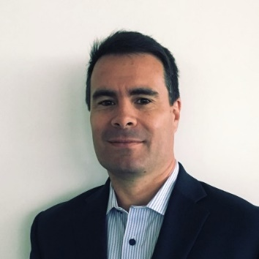
Company Management
Broad Base of Competence
Key Directors and Scientific Advisors
Dr Philip A Marshall | Chief Executive Officer | Director & Acting Chairman*
Over 40 years’ experience in all aspects of drug design and development. Recognized international expert in pharmaceutics and in the manufacture of medicines. Held senior executive roles in big and medium Pharma.
Founder and Director of global specialist consultancy firm to pharma & biotech. Authorized Aust Govt. GMP Auditor. Co-inventor of the key technology of novel compounds
Professor Wen G Jiang | Medicine and China Relations Advisor
Director of Cardiff China Medical Research Collaborative , UK Director of Cardiff University-Peking University Cancer Institute Honorary professorship at Peking University, Capital Medical University and Inner Mongolia Medical University, Consultant of Beijing Lung Cancer Centre. Created Scholarship in UK devoted to UK-China collaboration in medicine.
Dr K Michael Wayte | Director & Secretariat
Founder of company.
Cancer survivor.
Co-inventor of application patents.
Professor Giuseppe Giaccone | Special Scientific Advisor
Internationally recognized expert in the field of lung cancer and developmental therapeutics. Chief of Thoracic Oncology and Associate Director for Clinical Research at the Sandra and Edward Meyer Cancer Center, Weill Cornell Medicine and New York-Presbyterian Hospital
Dr Fernando Felquer | R&D Strategy & Project Management
Over 17 years of experience in drug development and biotech. Former VP, Business Development of international CRO vivoPharm. Founder and Director of the advisory firm Innovate Industry Services.
* Founding Chairman Prof Gordon McVie, pre-eminent and globally recognised cancer researcher sadly passed away in January 2021. Dr Marshall has assumed the Chair’s role until Stage I capital raise has been completed and a new independent chair can be appointed.
page
017

Slide 18
Partners & Collaborators
Entity Name | Location | Website
Charnwood Molecular | Loughborough, UK | https://charnwood-molecular.com/
Diamantina Institute, University of Queensland | Brisbane, QLD, Australia | https://di.uq.edu.au/
GlycoSyn | Lower Hutt, New Zealand | https://www.glycosyn.com/
Keystone Nano | Hershey, Pennsylvania, USA | https://www.keystonenano.com/
Microbial Screening Technologies | Smithfield, NSW, Australia | https://www.microbialscreening.com/
Peter MacCallum Cancer Institute | Melbourne, VIC, Australia | https://www.petermac.org/
QIMR Berghofer Medical Research Institute | Brisbane, QLD, Australia | https://www.qimrberghofer.edu.au/
Quotient Bioresearch | Cardiff, UK | https://www.contractpharma.com/csd/profile/quotient-bioresearch-ltd-
Southern Cross University, Centre for Photochemistry & Pharmacology | Lismore, NSW, Australia | https://www.scu.edu.au/southern-cross-plant-science/
TetraQ | Brisbane, QLD, Australia | https://www.tetraq.com.au/
Translational Research Institute, University of Queensland | Brisbane, QLD, Australia | https://www.tri.edu.au/translational-research-institute-australia
vivoPharm | (Formerly Adelaide SA), Hershey, Pennsylvania, USA | http://vivopharm.com.au/
Strong links with key opinion leaders, world-leading Australian academic research institutions and international service providers
page
018

Slide 19
Contact Details
Dr Philip A Marshall
CEO & Director – Oncology Research International Limited
Registered Office
Phone
Online
Level 5, 45 St Georges Terrace, Perth, WA 6000
Australia
M: +61 (0)401 657 477
Email: philip.marshall@oril.com.au
WeChat: PAMarshall54
Website: www.oril.com.au
page
019

